Slide 1
More assembly
C. Titus Brown
ctb@msu.edu
Sep 19, 2013

Slide 2
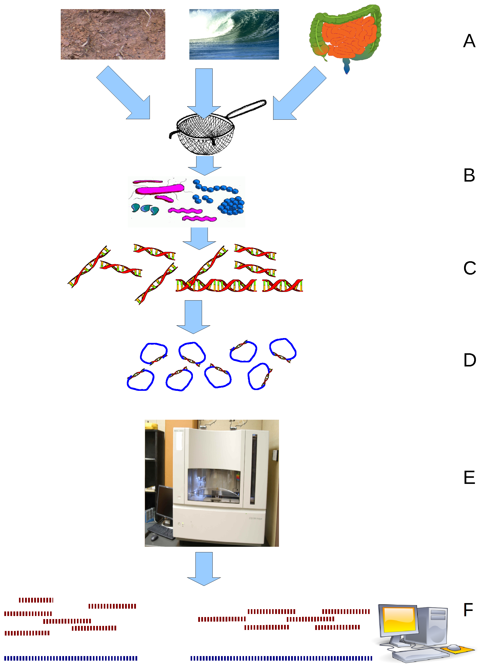
Shotgun metagenomics
Collect samples;
Extract DNA;
Feed into sequencer;
Computationally analyze.
Wikipedia: Environmental shotgun sequencing.png

Slide 3
Annotating individual reads
Works really well when you have EITHER
(a) evolutionarily close references
(b) rather long sequences
(This is obvious, right?)

Slide 4
Annotating individual reads #2
We have found that this does not work well with Illumina samples from unexplored environments (e.g. soil).
Sensitivity is fine (correct match is usually there)
Specificity is bad (correct match may be drowned out by incorrect matches)

Slide 5
Recommendation:
For reads < 200-300 bp,
Annotate individual reads for human-associated samples, or exploration of well-studied systems.
For everything else, look to assembly.

Slide 6
So, why assemble?
Increase your ability to assign homology/orthology correctly!!
Essentially all functional annotation systems depend on sequence similarity to assign homology. This is why you want to assemble your data.

Slide 7
Why else would you want to assemble?
Assemble new “reference”.
Look for large-scale variation from reference – pathogenicity islands, etc.
Discriminate between different members of gene families.
Discover operon assemblages & annotate on co-incidence of genes.
Reduce size of data!!

Slide 8
Why don’t you want to assemble??
Abundance threshold – low-coverage filter.
Strain variation
Chimerism

Slide 9
A story: looking at land management with 454 shotgun
Tracy Teal, Vicente Gomez-Alvarado, & Tom Schmidt
Ask detailed questions of @tracykteal on Twitter, please :)

Slide 18
Annotating soil reads - thoughts
Possible to find well-known genes using long (454) reads.
Normalize for organism abundance!
Primer independence can be important!
Note, replicates give you error bars…

Slide 19
Osedax symbionts
Goffredi et al., submitted.

Slide 20
Metagenomic assembly followed by binning enabled isolation of fairly complete genomes

Slide 21
Assembly allowed genomic content comparisons to nearest cultured relative

Slide 22
Osedax assembly story
Low diversity metagenome!
Physical isolation => MDA => sequencing => diginorm => binning =>
94% complete Rs1
66-89% complete Rs2
Note: many interesting critters are hard to isolate => so, basically, metagenomes.

Slide 23
Human-associated communities
“Time series community genomics analysis reveals rapid shifts in bacterial species, strains, and phage during infant gut colonization.” Sharon et al. (Banfield lab);
Genome Res. 2013 23: 111-120

Slide 24
Setup
Collected 11 fecal samples from premature female, days 15-24.
260m 100-bp paired-end Illumina HiSeq reads; 400 and 900 base fragments.
Assembled > 96% of reads into contigs > 500bp; 8 complete genomes; reconstructed genes down to 0.05% of population abundance.

Slide 25
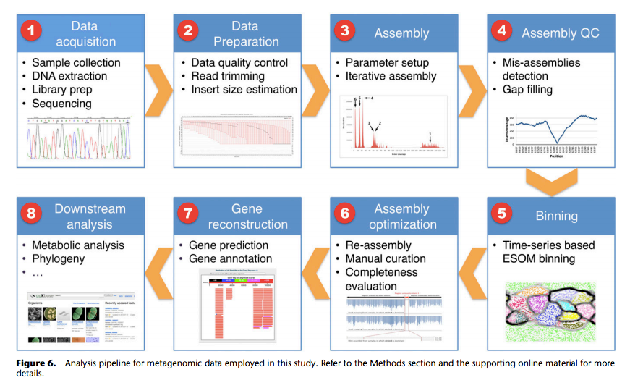
Sharon et al., 2013; pmid 22936250

Slide 26
Key strategy: abundance binning
Sharon et al., 2013; pmid 22936250

Slide 27
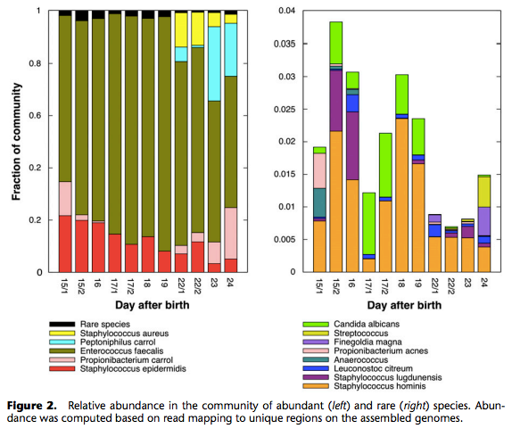
Sharon et al., 2013; pmid 22936250

Slide 28
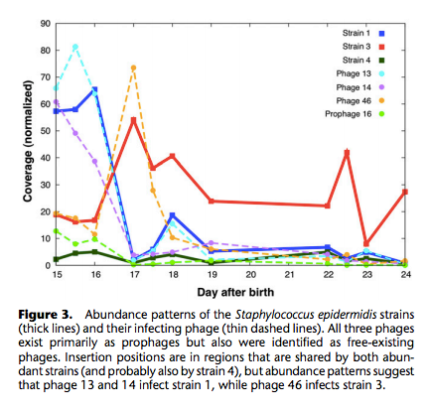
Tracking abundance
Sharon et al., 2013; pmid 22936250

Slide 29
Conclusions
Recovered strain variation, phage variation, abundance variation, lateral gene transfer.
Claim that “recovered genomes are superior to draft genomes generated in most isolate genome sequencing projects.”

Slide 30
Environmental metagenomics: Deepwater Horizon spill
“Transcriptional response of bathypelagic marine bacterioplankton to the Deepwater Horizon oil spill.” Rivers et al., 2013, Moran lab. Pmid 23902988.

Slide 31
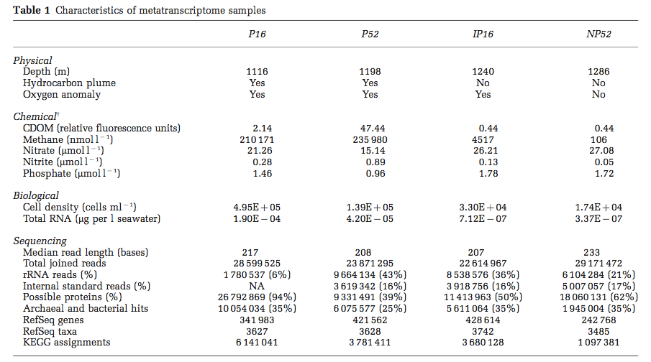
Sequencing strategy

Slide 32
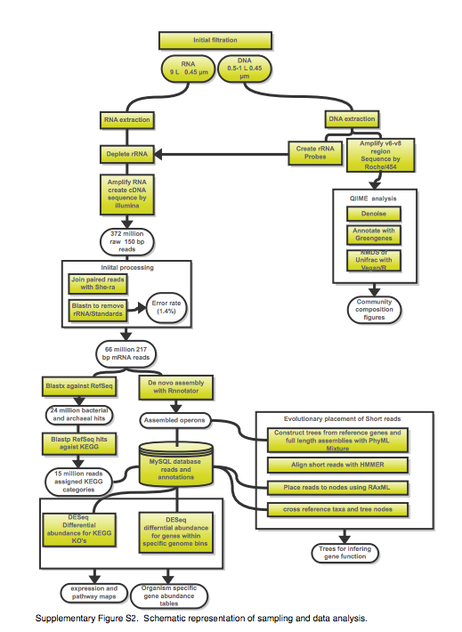
Protocol for messenger RNA extraction, assembly, downstream analysis, including differential expression.
Note: used overlapping paired-end reads.

Slide 33
Great Prairie Grand Challenge - soil
Together with Janet Jansson, Jim Tiedje, et al.
“Can we make sense of soil with deep Illumina sequencing?”

Slide 34
Great Prairie Grand Challenge - soil
What ecosystem level functions are present, and how do microbes do them?
How does agricultural soil differ from native soil?
How does soil respond to climate perturbation?
Questions that are not easy to answer without shotgun sequencing:
What kind of strain-level heterogeneity is present in the population?
What does the phage and viral population look like?
What species are where?

Slide 35
A “Grand Challenge” dataset (DOE/JGI)
Notes:
Beware of Janet Jansson bearing data.

Slide 36
Approach 1: Digital normalization (a computational version of library normalization)
Suppose you have a dilution factor of A (10) to B(1). To get 10x of B you need to get 100x of A! Overkill!!
This 100x will consume disk space and, because of errors, memory.
We can discard it for you…

Slide 37
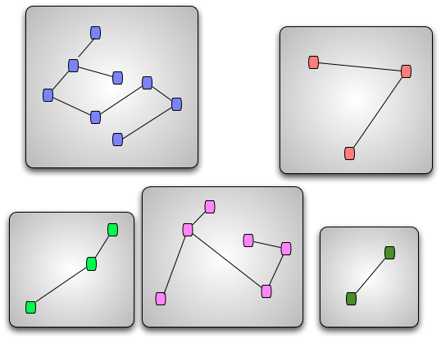
Approach 2: Data partitioning (a computational version of cell sorting)
Split reads into “bins” belonging to different source species.
Can do this based almost entirely on connectivity of sequences.
“Divide and conquer”
Memory-efficient implementation helps to scale assembly.

Slide 38
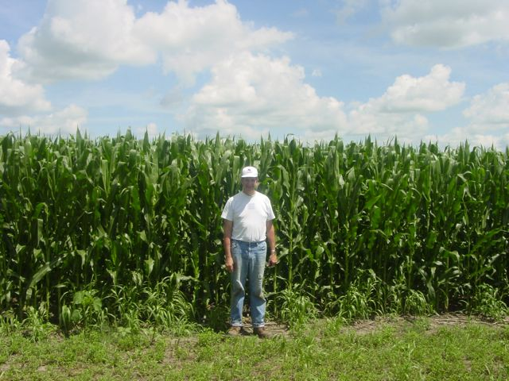
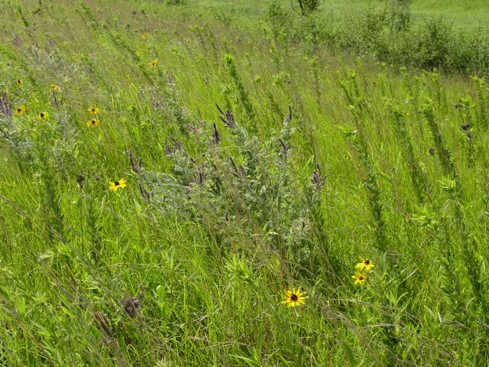
Assembly results for Iowa corn and prairie (2x ~300 Gbp soil metagenomes)
Total Assembly | Total Contigs (> 300 bp) | % Reads Assembled | Predicted protein coding
2.5 bill | 4.5 mill | 19% | 5.3 mill
3.5 bill | 5.9 mill | 22% | 6.8 mill
Putting it in perspective:
Total equivalent of ~1200 bacterial genomes
Human genome ~3 billion bp
Adina Howe

Slide 39
Resulting contigs are low coverage.

Slide 40
Iowa prairie & corn - very even.
Corn Prairie

Slide 41
Taxonomy– Iowa prairie
Note: this is predicted taxonomy of contigs w/o considering abundance or length. (MG-RAST)

Slide 42
Taxonomy – Iowa corn
Note: this is predicted taxonomy of contigs w/o considering abundance or length. (MG-RAST)

Slide 43
Strain variation?
Can measure by read mapping.
Of 5000 most abundant
contigs, only 1 has a
polymorphism rate > 5%
Top two allele frequencies
Position within contig
Notes:
Diginorm is a subsampling approach that may help assemble highly polymorphic sequences. Observed levels of variation are quite low relative to e.g. marine free spawning animals.

Slide 44
Concluding thoughts on assembly (I)
There’s no standard approach yet; almost every paper uses a specialized pipeline of some sort.
More like genome assembly
But unlike transcriptomics…

Slide 45
Concluding thoughts on assembly (II)
Anecdotally, everyone worries about strain variation.
Some groups (e.g. Banfield, us) have found that this is not a problem in their system so far.
Others (viral metagenomes! HMP!) have found this to be a big concern.

Slide 46
Concluding thoughts on assembly (III)
Some groups have found metagenome assembly to be very useful.
Others (us! soil!) have not yet proven its utility.

Slide 47
Questions that will be addressed tomorrow morning.
How much sequencing should I do?
How do I evaluate metagenome assemblies?
Which assembler is best?

Slide 48
High coverage is critical.
Low coverage is the dominant problem blocking assembly of metagenomes

